Slide 1

Project Management: Design, Produce, Evaluate
Overview of project management

Slide 2
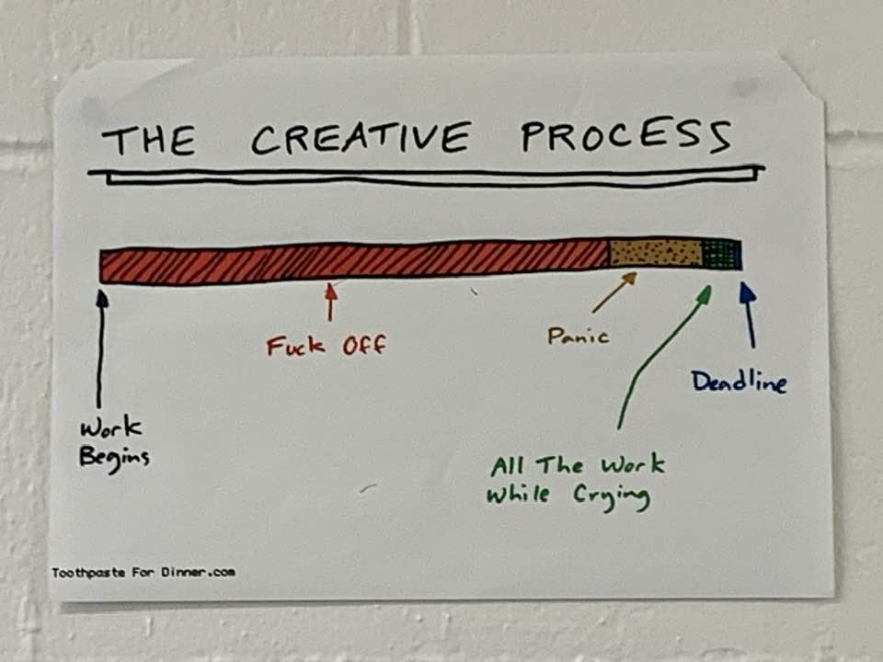
Leave Me Alone

Slide 3
What is a project?
A project is usually embarked upon in response to an identified problem or need.
It usually has a definite starting and ending point.
Large multimedia/digital media projects often have many different kinds of workers producing parts of the final project (human resources)
Different kinds of tools and skills might be needed throughout the creation of a project

Slide 4
Definition of a project:
A project is a planned piece of work which is completed over a period of time using specific resources and tools in accordance with the requirements (scope). It has a definite beginning and ending.

Slide 5
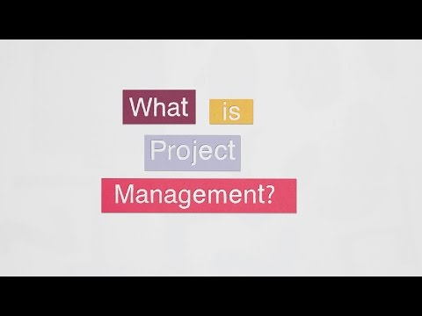
What is project management?

Slide 6
The project manager
A Project Manager is responsible for planning, overseeing and leading projects from ideation through to completion. This is a senior role at an organisation and requires interaction with a range of internal and external stakeholders, most often managing several moving project parts simultaneously.

Slide 7
Characteristics of a good project manager
Being a project manager is a specific kind of leadership position, which requires certain character traits and qualities. A good project manager delivers projects within the deadline and budget set by the clients, meeting or even exceeding the expectations of the stakeholders. But what does it take to make a good project manager great? Here are the top 10 qualities one must have to become a successful project manager.
Competence
Integrity
Problem Solving
Collaboration
Team Mindedness

Slide 8
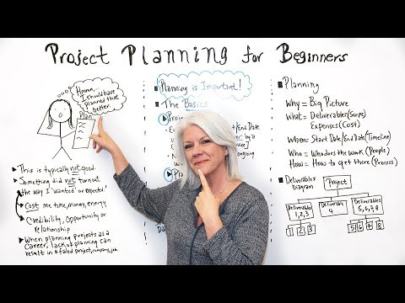
Project planning for beginners

Slide 9

Agile Project management - an iTerative process

Slide 10
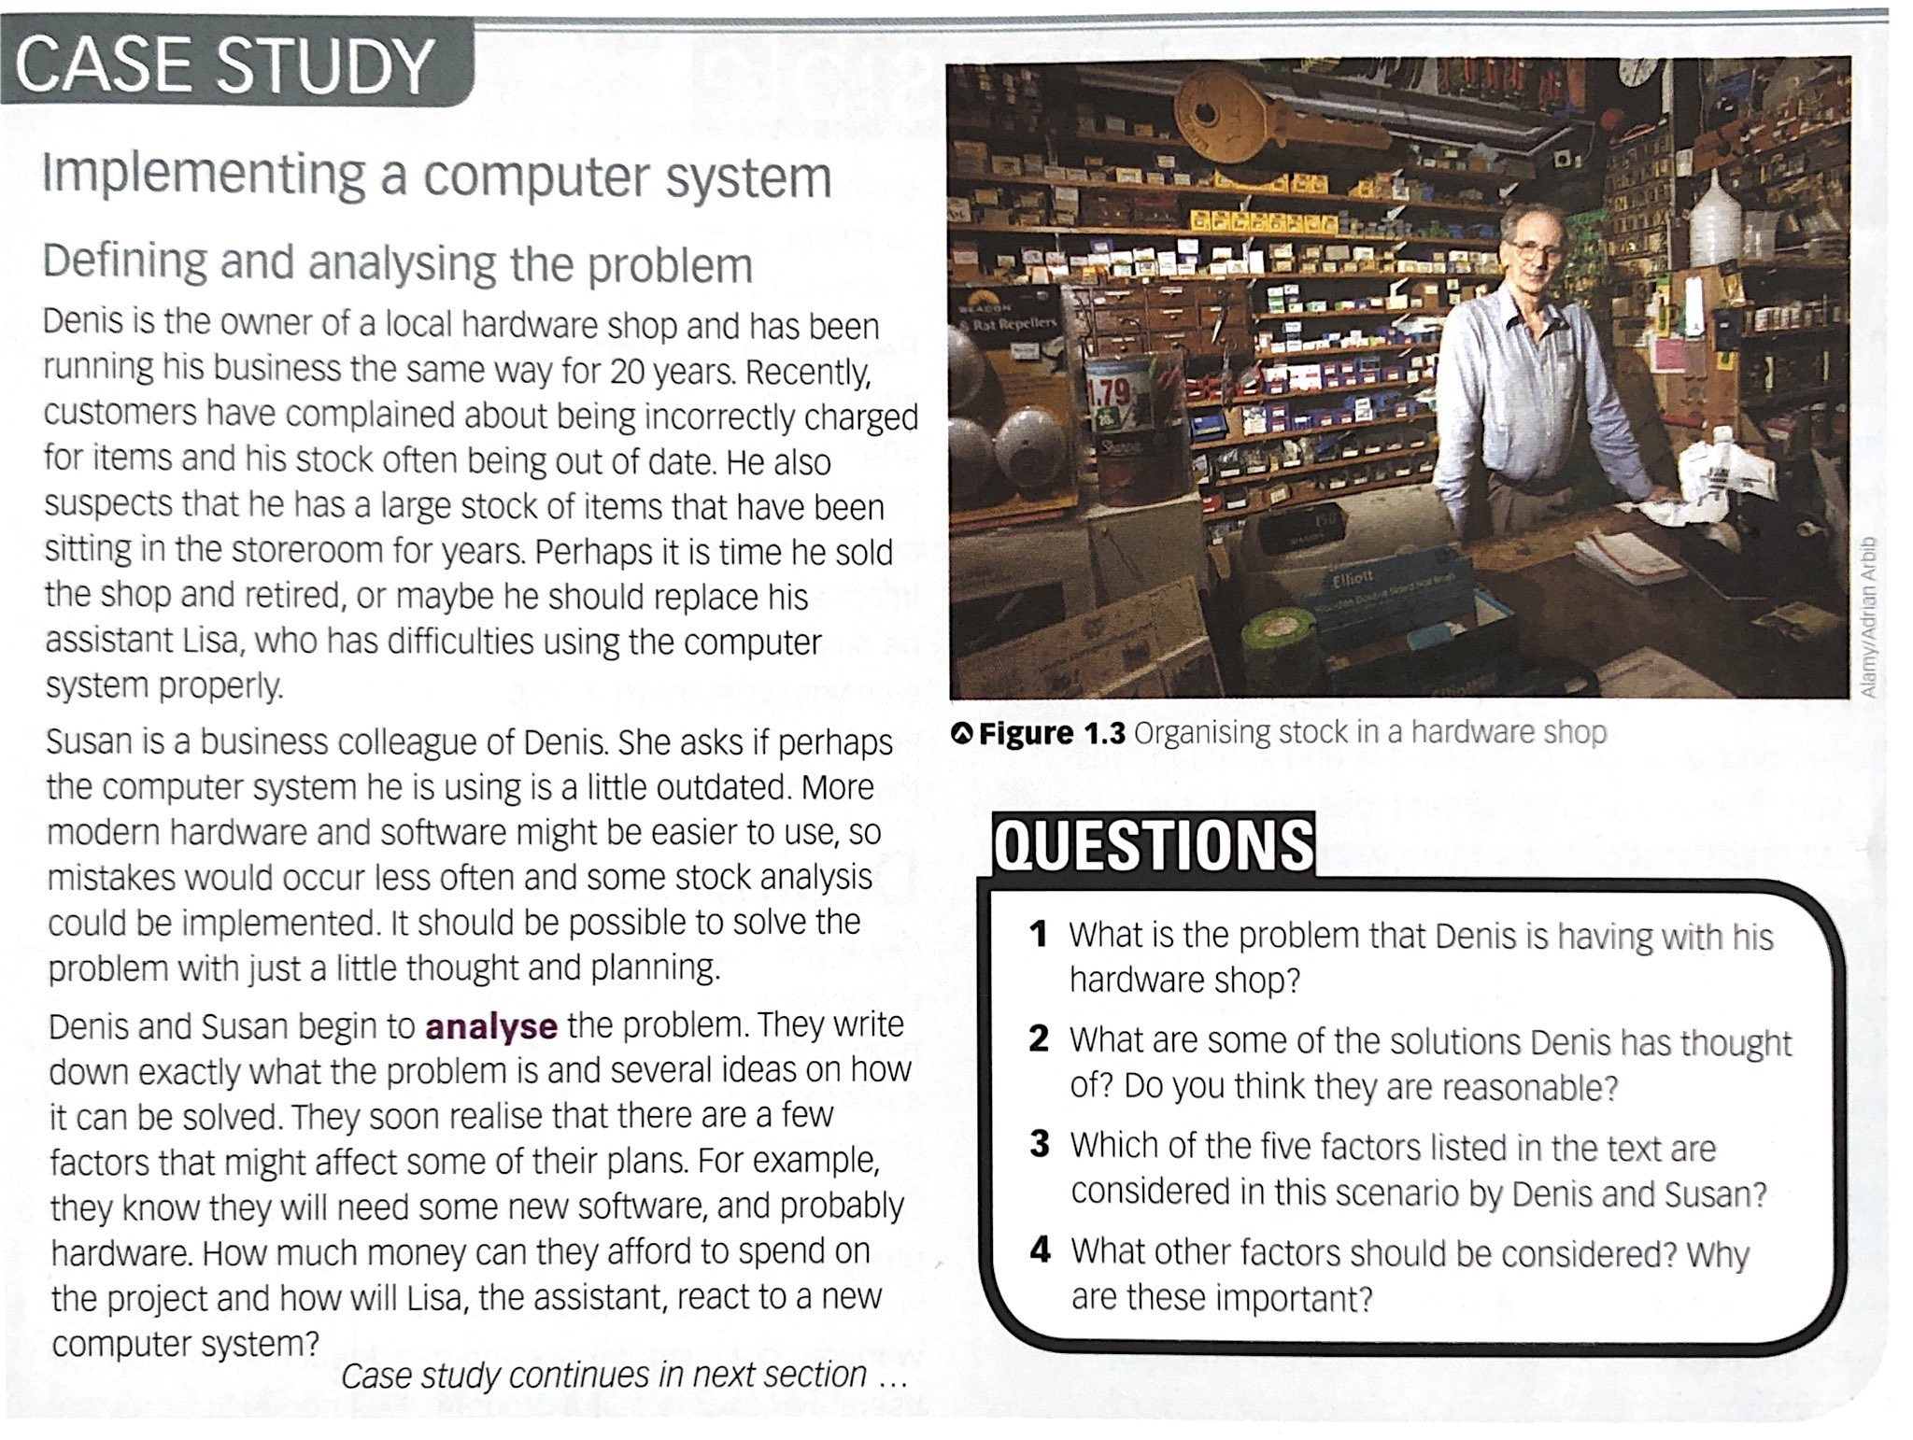
PROBLEM SOLVING

Slide 11
PROBLEM SOLVING
Designing possible solutions:
Our friends in the hardware shop write down some clear ideas on the time frame, budget and requirements for the new system. They start to use a database program to see how the information about stock and suppliers can be organised. Susan has seen a website which might give them some ideas for giving customers online access to information. She suggests that they could also collect details about their regular customers and introduce some marketing ideas such as loyalty reward schemes and special discounts.

Slide 12
Factors which Influence PROBLEM SOLVING
Understanding the problem
Hardware and software available
Communications
Time
Cost/Budget
Group work
What do you think needs to be done before the concept can be discussed?
What do you think the most important things are to consider when taking on a large project?

Slide 13
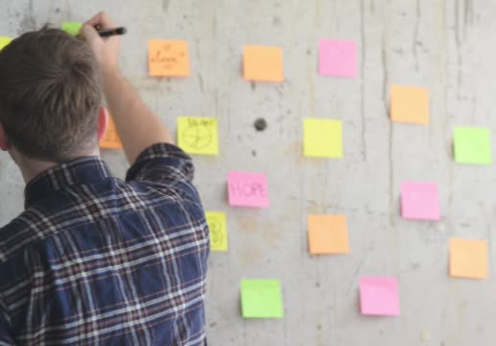
Designing Solutions: Generating ideas
It is said there are no bad ideas. All ideas are worth considering. One of the most important steps in design is to consult the users of the system.
Surveys, interviews and observation are all useful. (Remember UX design phase…?)

Slide 14
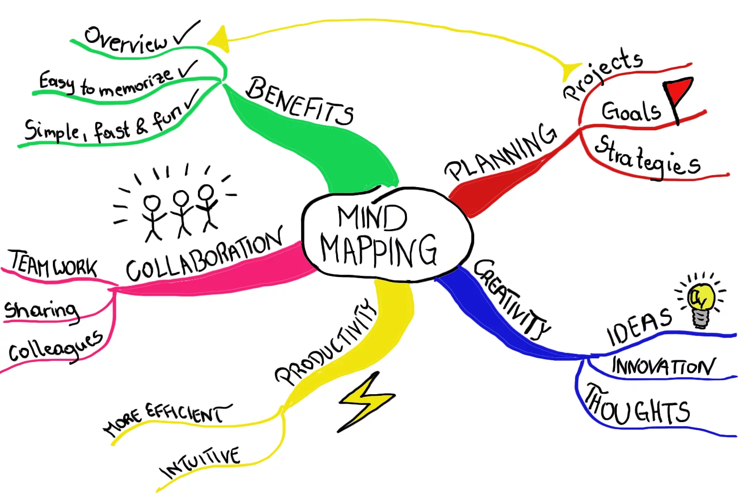
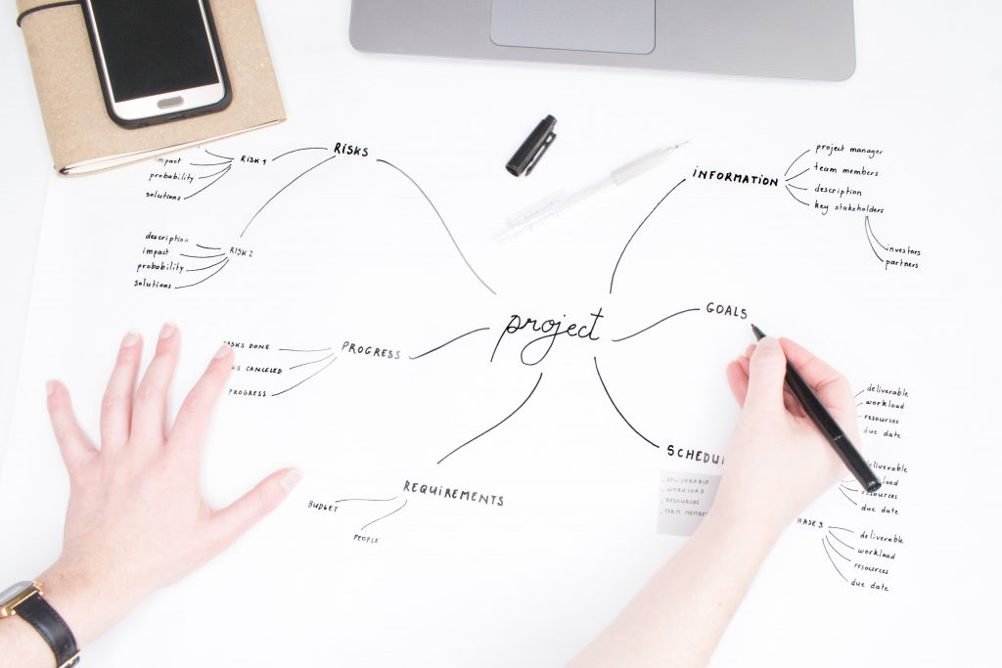
Designing Solutions: Mind Mapping
Mind mapping is a good way to generate and extend ideas before a lot of effort and time is spent on them.

Slide 15
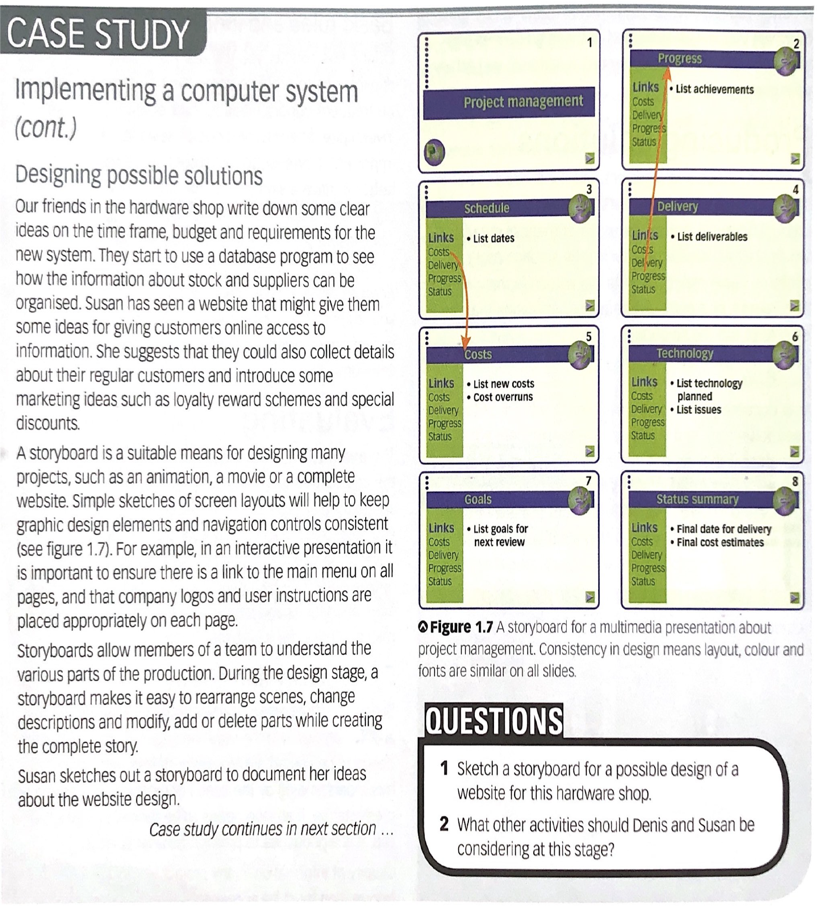
Designing Solutions: Storyboarding & Prototyping
Simple sketches will identify important elements, navigation controls etc.
This allows members of the team to understand the various parts of the production. During the design stage, a storyboard storyboard makes it easy to arrange elements to create the final vision.
Example Figure 1.7

Slide 16
Designing Solutions: Storyboarding & Prototyping
Simple sketches will identify important elements, navigation controls etc.
This allows members of the team to understand the various parts of the production. During the design stage, a storyboard storyboard makes it easy to arrange elements to create the final vision.
Example Figure 1.7

Slide 17
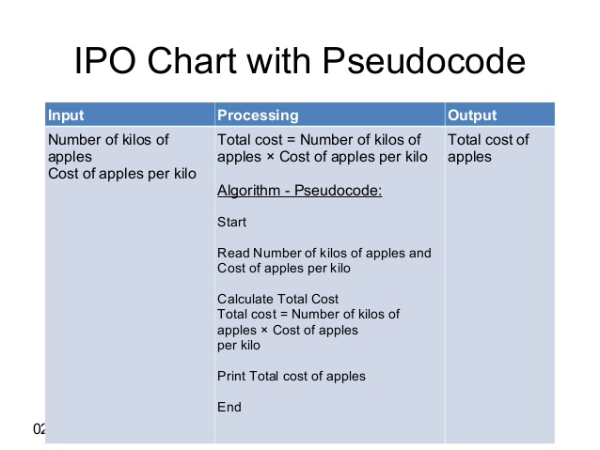
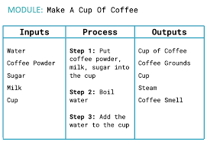
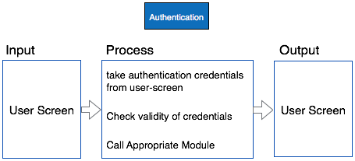
Designing Solutions: Input, processing, output tables
IPO Tables - Used when technology needs to be properly considered, especially for software development, forms etc. Very useful for planning interactive elements.

Slide 18
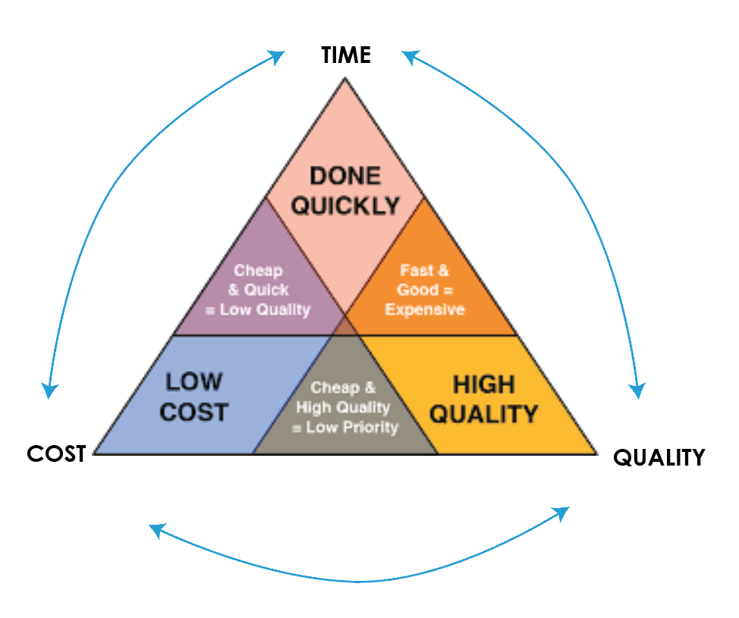
The ‘cost - quality - time’ trade-off
Time, Cost, and Quality can all become high priorities. The conventional wisdom is ‘pick two’. Let the third go.
(If you want it cheap and fast - quality options will shift)

Slide 19
The ‘cost - quality - time’ trade-off
If you want a product on time with a low cost, the team will likely have to cut functions, open tolerances, or sacrifice quality.

Slide 20
The ‘cost - quality - time’ trade-off
Setting priorities to achieve a high-quality product to meet a product launch window, the team may need additional money to hire staff, build prototypes faster, and use the best materials while adding the luxury set of features.

Slide 21
The ‘cost - quality - time’ trade-off
Given a budget for development and product costs yet wanting to meet specific quality levels may require more time to accomplish.

Slide 22
The ‘cost - quality - time’ trade-off
FAST
Fast, Good, Cheap is another triad invoking the same set of constraints.
Here the idea is customers want solutions that are better, less expensive, and available sooner than in the past.
CHEAP
GOOD

Slide 23
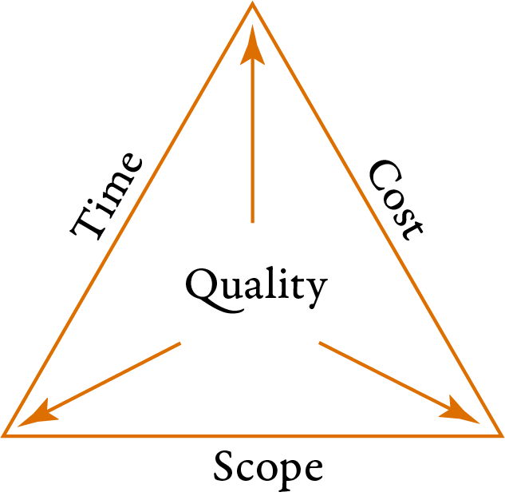
A better way?
If Scope is properly worked out and cost and time accurately identified - in theory there should still be the potential for quality.

Slide 24
The Primary Phases of a Project
There are 3 broad phases of to any project

Slide 25
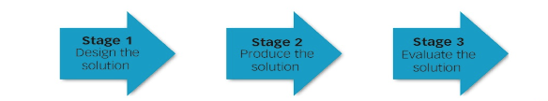
The Primary Phases of a Project
There are 3 broad phases or stages to any project

Slide 26
The Primary Phases of a Project
There are 3 broad phases or stages to any project

Slide 27
The Primary Phases of a Project
There are 3 broad phases or stages to any project

Slide 28
The Primary Phases of a Project
These can be broken down to be more specifically understood into 5 sub-groups:

Slide 29
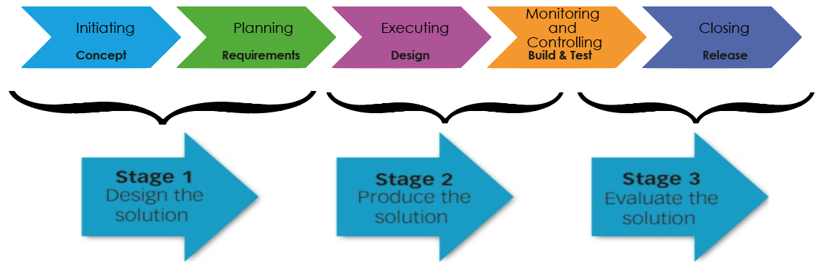
The Primary Phases of a Project

Slide 30
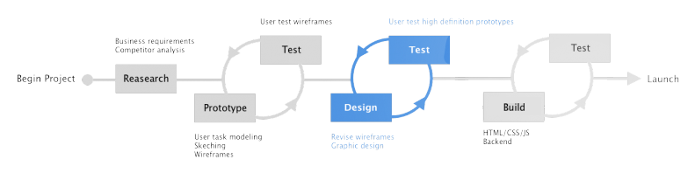
The Primary Phases of a Project - UX
Don’t forget the UX process is iterative
Research

Slide 31
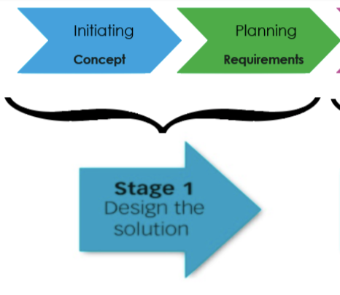
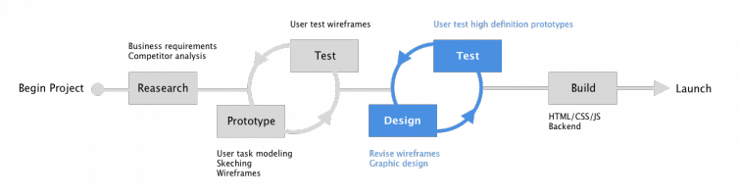
The Primary Phases of a Project
Initiating: processes performed to define a new project or a new phase of an existing project by obtaining authorization to start the project or phase. For this, an idea or concept is needed
Planning: Those processes required to establish the scope of the project, refine the objectives, and define the course of action required to attain the objectives that the project was undertaken to achieve.

Slide 32
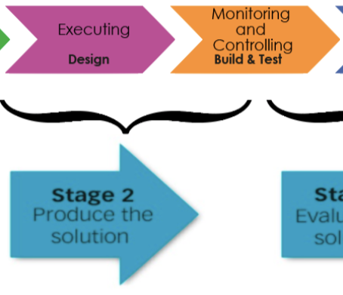
The Primary Phases of a Project
Executing: Those processes performed to complete the work defined in the project management plan to satisfy the project specifications

Slide 33
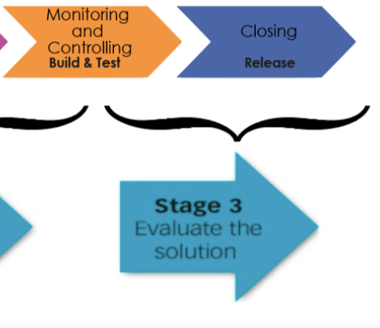
The Primary Phases of a Project
Monitoring and Controlling: Those processes required to track, review, and regulate the progress and performance of the project; identify any areas in which changes to the plan are required; and initiate the corresponding changes.
Closing: Those processes performed to finalize all activities across all Process Groups to formally close the project or phase.

Slide 34
Planning Time
Once you understand the scope of work you can identify human resources and plan the project.
Exercise: Plan your morning
Once you have written your morning outline, we will translate this into a Gantt style chart in Sheets, and allocate resources/costs.

Slide 35
Gantt Charts Baseline gantt = “The dream”
Gantt charts are a way of identifying what work needs to be done, in what time frame and by whom.
A BASELINE gantt chart tells us what the plan is from the outset. The project manager communicate to all members of the team to identify how much time is needed to complete tasks. Then this is allocated in logical order. Once the time is sorted out a cost can be associated with the tasks. This is how we give the client an idea of the costs of the project. The baseline gantt is like a blueprint and together with the proposal forms a contractual agreement with the client.

Slide 36
Gantt Charts Tracked gantt = “the reality”
A tracked gantt chart tells us what is actually happening while the project is underway. If something has been finished earlier we are ahead and therefore that part of the job has been cheaper. If it runs over then we are in trouble with our quote.
At the end of the job we look at the baseline plan vs the tracked plan, work out why things went over, what the impact on the cost is and this should help us plan better and charge differently in future.

Slide 37
Costing
So why not just charge more and not worry about the detail?
We still have to be commercially viable. We need to make enough to pay our staff and overheads while still not being so expensive that other companies can win our work.

Slide 38
Post IMplementation Review
This tells us the effectiveness of what we have done. Did we come in under or over budget/time.
Over time we would look to see if we had made the improvements which led to the client’s brief in the first place. This is measured by success metrics set out in the proposal.

Slide 39
Communication in projects
Identify methods of communication useful to group work?
What is a communication plan?
Why would one be necessary?

Slide 40
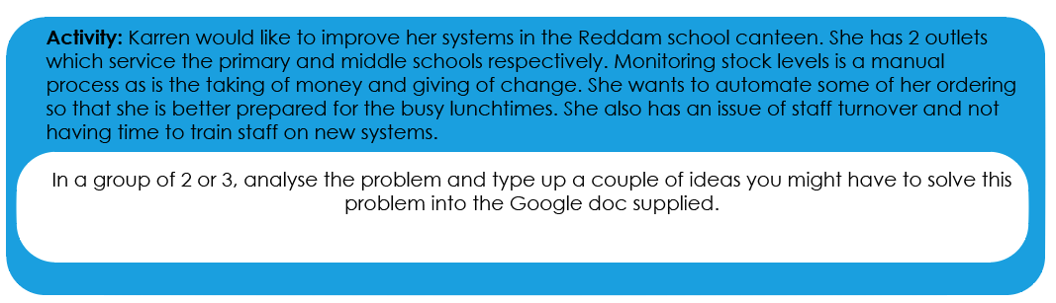
Activity
Type this into the space allocated in your CTech:Projects Google Doc

